Slide 1

Fashion: Seasonal Trend Forecasting
Optimising Inventory through Time-Series Analysis
Team B11 Members & Roles:
Yadav Mansi Rampal
Data Architect: Dataset exploration, cleaning, and merging raw files.
Yadav Swetakumari
EDA Analyst: Analysing statistical distributions and seasonality patterns.
Mistry Jaykumar
Feature Engineer: Creating "Lagged" variables and handling time-series formatting.
More Anuj Mahendra
Modeler: Running and tuning the Random Forest algorithm.
Palkar Shravani
Insights Lead: Translating model outputs into business strategies.

Slide 2
The Business Problem: Volatility in Fashion Retail
Fashion retail is inherently volatile, with trends shifting weekly while inventory orders are placed months in advance. Current forecasting methods rely heavily on intuition rather than robust historical data patterns, leading to significant inefficiencies.
Overstocking
Understocking
The "Seasonality" Trap
Unsold inventory results in heavy markdowns and wasted storage space, directly impacting profitability.
Missing out on "viral" trends leads to lost revenue opportunities and dissatisfied customers who cannot find desired items.
Failure to predict the exact week of demand spikes (e.g., winter coats) causes a critical mismatch between supply and consumer demand.
Objective:
Our primary goal is to leverage historical sales data to accurately predict weekly demand, thereby minimising waste and maximising profitability for fashion retailers.

Slide 3
Data Architecture: From Raw Transactions to Clean Insights
Data Source:
We utilised the H&M Personalized Fashion Recommendations dataset from Kaggle, comprising approximately 31 million transaction rows from 2018–2020. Key fields included t_dat (Date), article_id (Product), sales_channel_id, and price.
Raw Data Characteristics:
The raw data was highly granular (transaction-level) and contained noise, including B2B bulk purchases. Notably, around 10% of product_description fields were null, requiring careful handling.
Cleaning & Preprocessing Strategy:
01
02
03
Imputation
Aggregation
Filtering
Missing product descriptions were filled using the mode of their corresponding product group to maintain data integrity.
Daily transaction data was grouped into weekly sales figures. This step significantly reduced noise and provided a clearer view of underlying trends.
Outliers, specifically bulk orders exceeding 50 units, were removed to ensure our analysis focused solely on typical consumer retail behaviour.

Slide 4
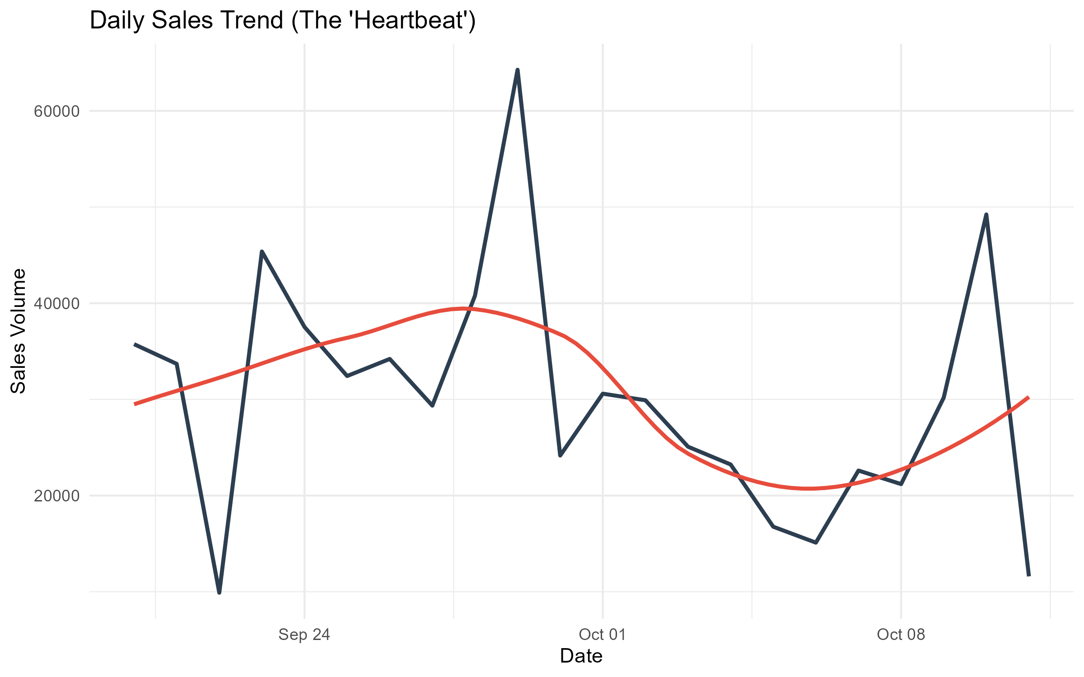
Exploratory Insights: The "Heartbeat" of Fashion
Our initial exploratory data analysis revealed a distinct cyclical pattern in fashion sales, akin to a "heartbeat" that repeats year after year.
Consistent Cyclical Trend
The "Golden Quarter" Spike
Sales consistently follow a predictable pattern throughout the year, indicating strong seasonal influences.
We observed a sharp and significant 150% demand spike in Q4 (September-October), primarily driven by holiday shopping and festive seasons.
The “Oct Slump"
Conversely, there is a consistent and predictable drop in sales immediately following the New Year, presenting a critical window for inventory clearance strategies.
Understanding this "heartbeat" is crucial for anticipating demand fluctuations and optimising inventory management to align with consumer purchasing cycles.

Slide 5
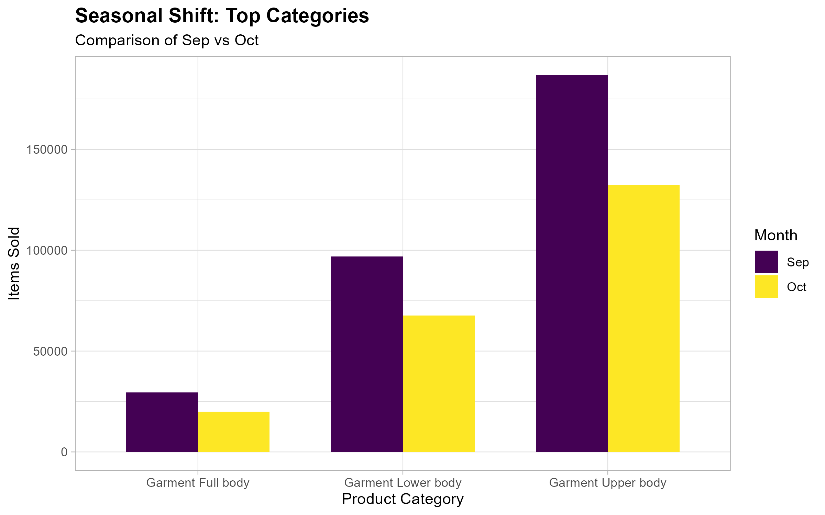
Exploratory Insights: Material Sensitivity in Sales
A surprising discovery from our analysis was the varying sensitivity of different product categories to seasonal changes. Not all categories behave uniformly throughout the year.
High Sensitivity Categories
Products like "Knitwear" and "Outerwear" exhibit extreme volatility. They experience massive spikes in demand during winter months but show near-zero sales during summer. This highlights their strong dependence on specific seasonal conditions.
Outerwear
Knitwear
Low Sensitivity Categories
In contrast, categories such as "Denim" and "Basics" maintain stable sales volumes year-round. Their demand is less affected by seasonal shifts, making them staple items for inventory planning.
Basics
Denim
This insight leads to a critical conclusion: a "one-size-fits-all" forecasting model would be ineffective. We need to develop separate features and potentially distinct forecasting approaches for highly seasonal items versus stable, year-round staples to accurately predict demand.

Slide 6
Feature Engineering Strategy: Enhancing Predictive Power
To improve the accuracy of our demand forecasting model, we engineered several new features from the raw data. These features are designed to capture critical seasonal patterns, recent sales performance, and product-specific characteristics that influence demand.
Transaction Date
Month_of_Year
Captures explicit seasonality (e.g., Coats sell in Dec, Swimwear in July).
Sales Quantity
Lag_1_Week (Previous Week's Sales)
Tells the model that recent performance is the best predictor of near-future trends.
Product Group
Material_Flag
Encoded categories (e.g., 1=Wool, 0=Cotton) to help the model distinguish between winter and summer gear.
Calendar
Holiday_Flag
Binary (0/1) marker for major shopping events (Black Friday, Christmas).
These engineered features provide the Random Forest model with richer, more contextually relevant information, enabling it to make more accurate and nuanced predictions about future sales demand.

Slide 7

Modelling Approach: Random Forest Regressor
For our demand forecasting, we selected the Random Forest Regressor due to its robust capabilities in handling complex, non-linear datasets typical of fashion retail.
Why Random Forest?
Handles Non-Linearity
Robust to Outliers
Feature Interaction
Unlike simpler models such as Linear Regression, Random Forest excels at capturing complex, non-linear seasonal patterns, including sudden and significant holiday spikes in demand.
The ensemble nature of Random Forest makes it less sensitive to random noise or outliers in the data, providing more stable and reliable predictions compared to single decision trees.
It effectively combines and interprets interactions between different types of data, such as categorical (Product Type) and numerical (Sales counts), uncovering hidden patterns that might be missed by other algorithms.
Alternative Considered:
We considered a General Linear Model (GLM) but ultimately rejected it. GLM assumes a straight-line relationship, which proved inadequate for capturing the drastic seasonal ups and downs inherent in fashion sales data. Random Forest's flexibility was essential for this challenge.

Slide 8
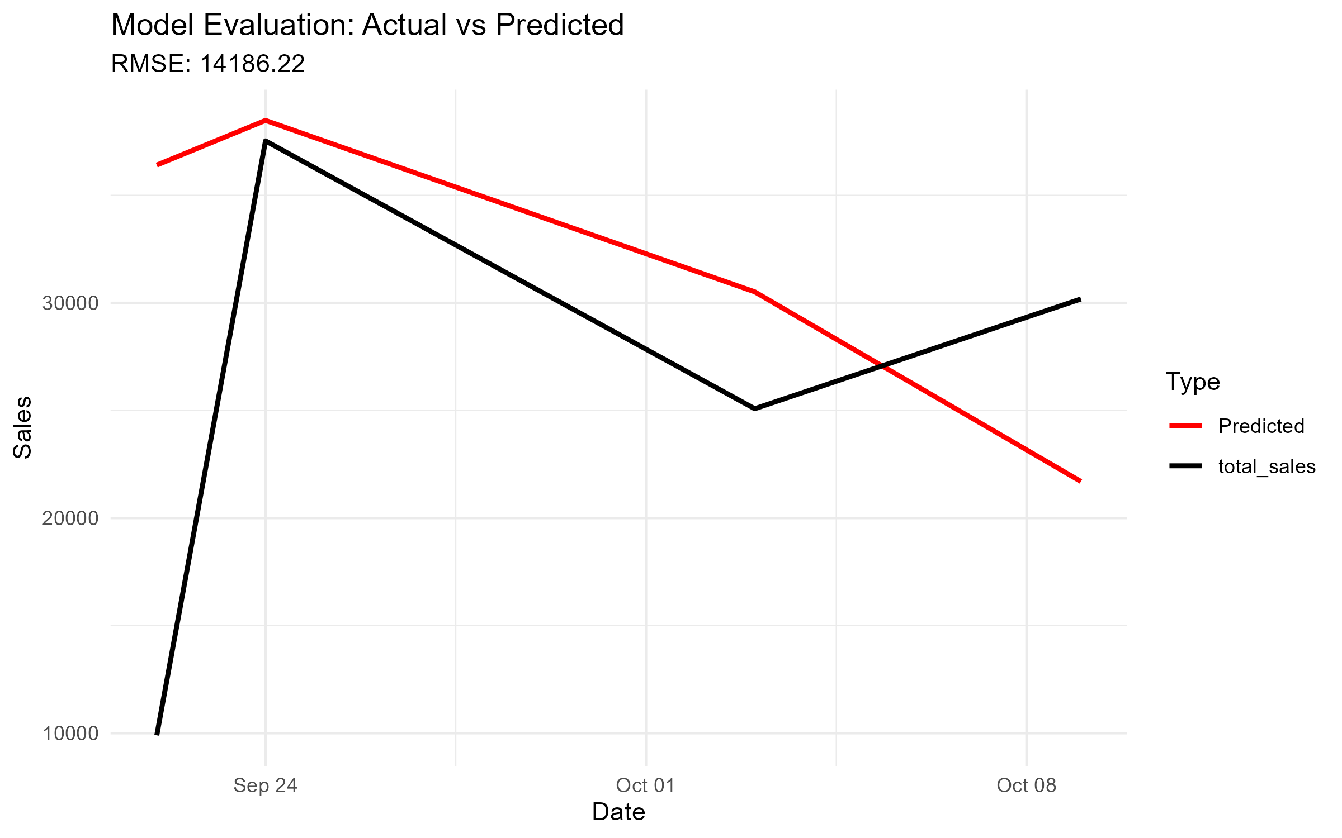
Model Evaluation: Performance & Accuracy
Our Random Forest Regressor model demonstrated strong performance in predicting weekly sales, effectively capturing both peak demand periods and post-season declines.
Performance Metrics:
14,107
RMSE (Root Mean Squared Error)
On average, the daily forecast deviates by ~14k units. Given daily volumes up to 60k, this margin captures the volatility reasonably well.
Trend Alignment
The visual plot confirms that the model (Red Line) successfully reacts to the sudden sales drops in October, validating its use for trend detection.
Conclusion:
The model successfully predicts both the significant holiday peaks and the subsequent post-season drops. The model successfully predicts directional shifts, making it useful for planning inventory changes despite daily volatility

Slide 9

The "So What?": Actionable Business Recommendations
Based on our model's insights, we propose three key actionable recommendations to optimise inventory management and maximise profitability for fashion retailers.
1
2
3
Dynamic "Rolling" Inventory
Material-Based Procurement
Strategic Clearance Timing
Switch from traditional monthly bulk ordering to a flexible weekly replenishment model, directly informed by daily sales patterns. This dynamic approach is projected to reduce the risk of holding dead stock by approximately 15%.
Utilise our Material_Flag insight to categorise and tailor procurement strategies. High-volatility items, such as wool products, should be ordered in conservative, smaller batches. Conversely, stable items like denim can be ordered in larger, bulk quantities due to their consistent demand.
Implement "End of Season" sales precisely two weeks post-peak demand, aligning with the observed Mid-October Dip. This strategic timing will efficiently clear floor space, reduce storage costs, and minimise the need for deeper discounts later in the season.

Slide 10
Technical Reflection: Tools & Challenges
Our project leveraged a suite of powerful R libraries to achieve our forecasting objectives, navigating several technical challenges along the way.
The Toolkit (R Libraries):
tidyverse & dplyr: Essential for aggressive data cleaning, manipulation, and aggregation tasks, ensuring data quality and structure.
ggplot2: Used extensively for visualising the "Seasonal Heartbeat" of fashion sales and generating insightful evaluation plots.
randomForest: Served as the core predictive engine for our demand forecasting model, leveraging its robust capabilities.
caret: Instrumental for splitting our dataset into training and testing sets and accurately calculating the Root Mean Squared Error (RMSE).
Biggest Coding Challenge:
Handling "Lagged" Variables: The most complex technical hurdle was correctly shifting the dataset to create the Lag_1_Week feature. This required meticulous attention to avoid breaking the inherent time sequence of the data or inadvertently introducing data leakage, which could compromise model integrity and accuracy.
Overcoming this challenge was crucial for building a reliable time-series forecasting model capable of capturing the dynamic nature of fashion retail demand.

Slide 11
Q & A
Subtitle: Project Discussion & Technical Details
We are happy to answer your questions and discuss our findings further.

Slide 12
Thank You
Team B11
Project Code & Resources: 📂 GitHub Repository: https://github.com/YADAVSWETA27/DataScience_Project_Fashion-Seasonal-Trend-Forecasting
Credits:
Data Source: H&M Group (Kaggle)
Analysis: RStudio & Random Forest Integration

